Slide 1
Welcome to Introduction to Data Science!

Slide 2
Hi! My name is Aritro Majumdar
Graduate from Galvanize Data Science Immersive Program (Feb 2018)
Junior at ASU studying Mathematics
Data Science Intern @ Kono.store

Slide 3

What is Data Science?
Not to be basic but…

Slide 4
3 Components
Coding Statistical Analysis
Machine Learning
Deep Learning

Slide 5


History
SAS
BUT…
$9000
For the base model..
When computing power increased and became more accessible, statisticians used programming languages like R (free) and Python (free) to solve complex problems then data science was born

Slide 6
1. Coding Statistical Analysis:
Hypothesis testing
ANOVA
A/B Testing
Etc.

Slide 7
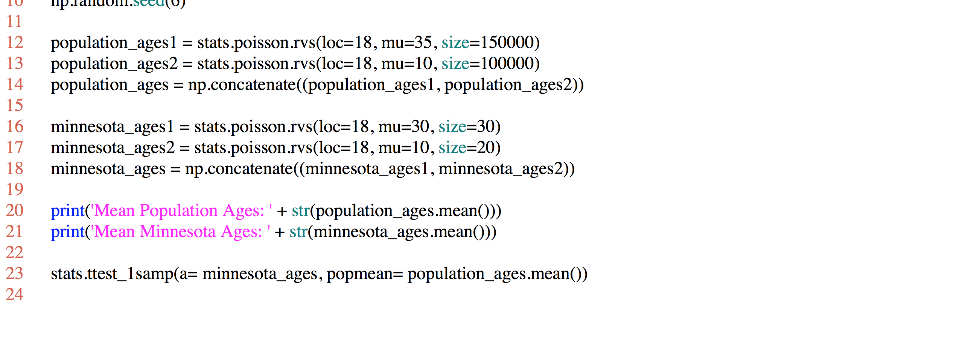
Coding Example: Hypothesis Testing

Slide 8
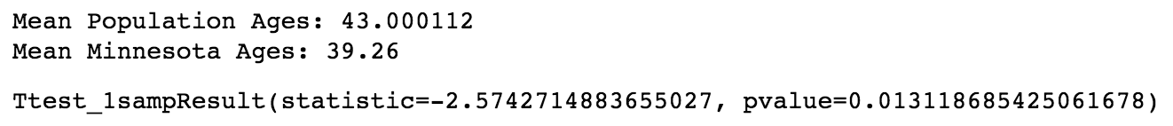
Example Output:

Slide 9
2. Machine Learning:
Reinforcement Learning
Supervised Learning
Unsupervised Learning

Slide 10
Reinforcement Learning:
Examples:
AlphaGo
DeepBlue
Video Games

Slide 11
Supervised Learning:
Refers to a set of samples where the desired output signals (labels) are already known. The training set then becomes the basis for predicting unknown similar sets
This is really the bread and butter of ML right now

Slide 12
Regression Examples:
Stock prices
House price sales
Temp forecasting

Slide 13
Popular Regression Algorithms:
Old Trusty -- Linear Regression
KNN
Random Forest
Gradient Boosting

Slide 14
Classification Examples:

Slide 15
Popular Classification Examples:
Logistic Regression
KNN

Slide 16
More Classification Examples:
Random Forest
Gradient Boosted Trees

Slide 17
Unsupervised Learning:
Refers to a set of samples where the desired output signals (labels) are unknown. We explore and define the data relatively to one another without guidance from known variables

Slide 18
Unsupervised Learning Examples:
Topic modelling (segment customers, find topics of a text corpus)
Natural Language Processing
Recommendation engines -- really cool! Content vs Collaborative filtering (Pandora vs Spotify)

Slide 19
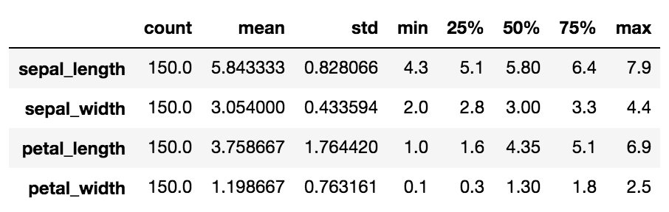
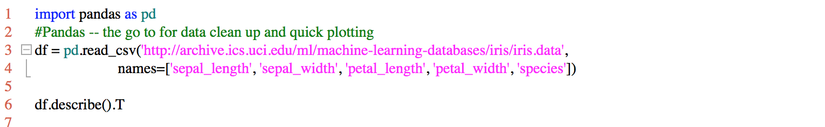
Coding Example: Logistic Regression

Slide 20
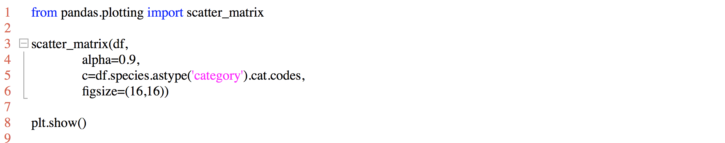
Coding Example: Logistic Regression (cont.)

Slide 21
Coding Example: Logistic Regression (cont.)

Slide 22
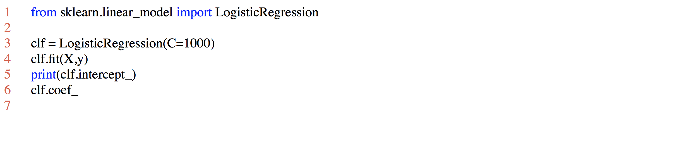
Coding Example: Logistic Regression (cont.)

Slide 23
3. Deep Learning:
Artificial Neural Newwork
Generative Adversarial Networks (GAN)
Convolutional Neural Network (CNN)
Recurrent Neural Network (RNN)
Keras

Slide 24

Coding Examples:

Slide 25
Deep Learning Resources:
https://machinelearningmastery.com/tutorial-first-neural-network-python-keras/
https://www.datacamp.com/courses/deep-learning-in-python

Slide 26



Data Science Flow Overview:

Slide 27
Data Science Workflow

Slide 28
1. Business Understanding
Every thing starts with business understanding. Speak with your stakeholders:
What is the business problem you need to answer?
What are the requirements?
How do you measure success?
Do not proceed until you have answered these questions. Often, it is not clear what success looks like or even what you should use as a label (target) to train you model. The metric for success will typically be a business quantity like 'decrease churn rate 10%' instead of improving AUC or MAPE. Consequently, you need to tune your model based on the right business outcome. Make sure you always state results in business terms like this policy will save $100 MM or decrease fraud by 10%.
Note: These steps are an interative process. E.g., after performing a step, such as Modeling, you may discover a mistake which causes you to repeat an earlier process, such as data cleaning.

Slide 29
2. Data Understanding
After you define the business problem, you need to determine what data is available. Ponder the following:
What datasets are available?
How can you combine them to produce a dataset to answer their business questions?
Do you need to collect additional data?
Does your data have a label (target) or do you need to generate one, perhaps by using MechTurkor equivalent?

Slide 30
3. Data Preparation
To prepare a dataset for modeling, you should first explore the data and, concurrently, figure out how to clean it. At the end of this step, you should have a dataset you can use to build a model.

Slide 31
3a. Load data and perform minimal cleaning
Start by loading your data so that you can begin exploring it. Perform only the most minimal cleaning necessary -- overcleaning can remove valuable information (signal).
Pro tip: if your data is huge, start by making sure everything works on a small subset of your data, like a single shard. You want to be able to interate quickly and get your pipeline working before attempting full-scale analysis and modeling.

Slide 32
3b. Exploratory Data Analysis
Get to know the strengths and weaknesses of your data:
What are the strengths and weaknesses?
Any weird values? outliers? missing values? malformed/unstructured fields?
What is the nature of your missing values? Are they missing at random? If not, how are you going to deal with them?
Compute summary statistics
Plot features to see if they have predictive power? If you have a lot of data, draw a subset -- and make sure your results don't depend on the subset you have chosen.
Plot histograms of label and key features

Slide 33
3c I. Feature Engineering
Finally, assemble your final dataset. Feature engineering -- how you construct the features for your model -- is often more important than what model you choose. Some issues:
Compute a target/label if one doesn't exist -- this will require domain expertise
Handle missing values -- can you bin or are missing values missing at random so you can drop them?
Handle outliers -- should you bin the data to make it discrete?
Replace categorical variables with dummy variables, which scikit-learn requires, unlike R

Slide 34
3c II. Feature Engineering
Transform data:
Take log of data, which is often useful with long-tailed data
Possibly, quantize continuous to handle non-linear behavior
Convert text data to features using:
Natural Language Processing (NLP)
Term frequency-inverse document frequency (TF-IDF)
feature hashing trick
Compute n-grams, etc.
Rationalize address data into standard USPS format
Be careful to avoid using endogenous features, i.e., those which are codetermined with the outcome. For example, if you regress quantity on price, priceis almost always endogenous because it is codetermined from the interaction between the buyer and the seller. Consequently, in the regression model
Now you should be ready to start modeling...

Slide 35
4. Modeling
Start by producing a 'shitty' first model. If it performs too well, you should be suspicious. Look for information leakage, i.e., a single variable which predicts the outcome (almost) perfectly. This often happens with time series data when you have a feature which contains information from future periods. It also occurs, when a feature is derived from the label. You may want to run one-in or one-out reports to test for this problem.
Next refine the model and determine which features are important. You should use cross-validation to tune parameter settings and find a candidate model. Use diagnostic tools to determine which features are most important. Do the results agree with your intuition? Also, test that the assumptions needed to use your model are satisfied.

Slide 36
5. Evaluation
Before releasing the model to the wild, you should evaluate it. One of the best ways to do this is to design and run an experiment such as an A/B test. If that is not possible chose a suitable method that let's you determine causally whether your awesome new model has the desired impact.

Slide 37
6. Deployment
Finally, you model is ready for deployment! Then the process will start all over: you may need to keep retraining and retuning the model as the competitive environment changes. Also, follow on studies are common, so plan for change!

Slide 38
Conclusion
Most likely at several points along the workflow, you will need to present your results to non-technical (MBA) stakeholders. Make sure you have a easily digested explanation and graphic to support your findings. Modern companies are keen to make data-driven decisions. As a data scientist, you are a key part of this revolution -- doing things according to the 4Ps is no longer good enough, because we are drowning in data and can measure what actually works.

Slide 39
Questions?

Slide 40

Thank you!
Join Data Science PHX!
https://www.facebook.com/datasciencephx/
https://datasciencephx.slack.com

